Slide 1
Tnsdc – generative ai for engineering
final project
submitted by
LAKSHMI.R

Slide 2
PROJECT TITLE
TEXT PARAPHRASER USING
TRANSFORMER(PEGASUS)

Slide 3
AGENDA
Problem Statement
Project Overview
End Users
Value Proposition
Solution
Modelling
Results

Slide 4
PROBLEM STATEMENT
Develop a paraphrasing tool that can generate multiple paraphrases for a given input text. The tool should utilize advanced natural language processing techniques, specifically transformer-based models, to produce paraphrases that accurately convey the meaning of the original text. The paraphrasing tool should be efficient and capable of handling various types of input text, such as sentences, paragraphs, or entire documents. The goal is to provide users with a reliable and versatile tool for generating paraphrases that can be used in a wide range of applications, including content creation, text augmentation, and language understanding tasks.

Slide 5
PROJECT OVERVIEW
Our project aims to develop an advanced paraphrasing tool using transformer-based models. With a focus on preserving original meaning, it generates multiple paraphrases for input text. Leveraging the Pegasus model, the system tokenizes and encodes input, generates paraphrases, and facilitates integration into diverse applications, enhancing text processing capabilities across various domains.

Slide 6
PROJECT OVERVIEW - OBJECTIVE
Develop a paraphrasing tool leveraging transformer-based models to generate multiple paraphrases for input text.
Ensure that the generated paraphrases accurately preserve the original meaning of the input text.
Implement efficient tokenization, encoding, and decoding mechanisms to process input text and generate paraphrases.
Provide a user-friendly interface for seamless interaction with the paraphrasing tool.
Enable integration of the paraphrasing tool into diverse applications to enhance text processing capabilities.
Optimize the system for scalability, efficiency, and accuracy to meet the needs of various user scenarios.
Continuously update and improve the paraphrasing tool based on user feedback and advancements in NLP techniques.

Slide 7
project overview – expected outcome
The expected outcome is the generation of paraphrased sentences based on the input text. The system utilizes the Pegasus model to produce multiple paraphrases for each sentence in the input context. These paraphrases are crafted to maintain the original meaning while presenting diverse linguistic variations. The resulting output comprises paraphrased sentences, collectively forming a rephrased rendition of the input text.

Slide 8
END USERS
Content creators: Writers, bloggers, and social media influencers who frequently produce written content and require variations for engagement and SEO purposes.
Students and educators: Academic professionals and students who need to paraphrase texts for research papers, essays, and study materials to avoid plagiarism and enhance comprehension.
Researchers: Scientists, scholars, and researchers who rely on paraphrased data for literature reviews, data analysis, and synthesizing research findings.
Business professionals: Marketing professionals, advertisers, and content marketers who need to create diverse marketing materials, advertisements, and promotional content to reach different audiences effectively.
Language learners: Individuals learning a new language who utilize paraphrased texts to improve vocabulary, grammar, and comprehension skills through exposure to varied linguistic structures and expressions.

Slide 9
VALUE PROPOSITION
Transformer(Pegasus) based paraphrasing tool offers multifaceted benefits across diverse domains. It swiftly generates multiple paraphrases, enhancing productivity and saving time. Ensuring originality while preserving meaning, it supports academic integrity and aids comprehension. Additionally, it fosters creativity by exploring varied linguistic expressions, catering to writers and marketers. Overall, it streamlines workflows, promotes originality, supports learning, and facilitates creative expression, making it a versatile solution for users.

Slide 10
Solution.
Paraphrasing Tool(Pegasus): Utilizes advanced natural language processing techniques to swiftly generate multiple paraphrases, ensuring originality while preserving the original meaning for diverse user needs.
User-Friendly Interface: Features a seamless and intuitive interface for easy interaction, enhancing user experience and facilitating efficient text processing.

Slide 11
modelling
The modelling approach employs transformer-based architectures, particularly the Pegasus model, for paraphrase generation. These models leverage large-scale pretraining on diverse text corpora to capture intricate linguistic patterns and semantics. Fine-tuning techniques are then applied to adapt the model to the specific task of paraphrasing. The resulting model exhibits robustness, accuracy, and efficiency, enabling it to generate high-quality paraphrases while preserving the original meaning and context of the input text.

Slide 12
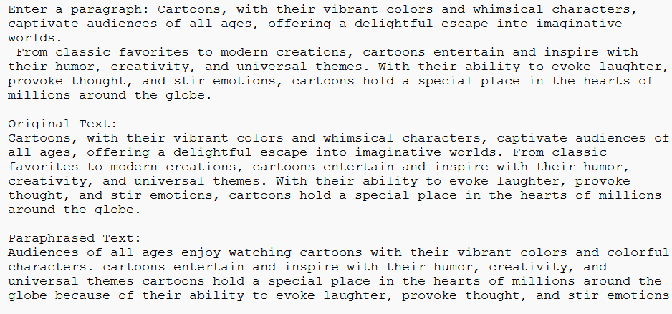
results

Slide 13
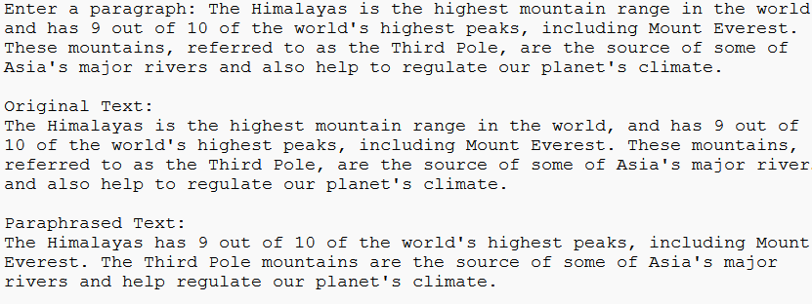
results

Slide 14
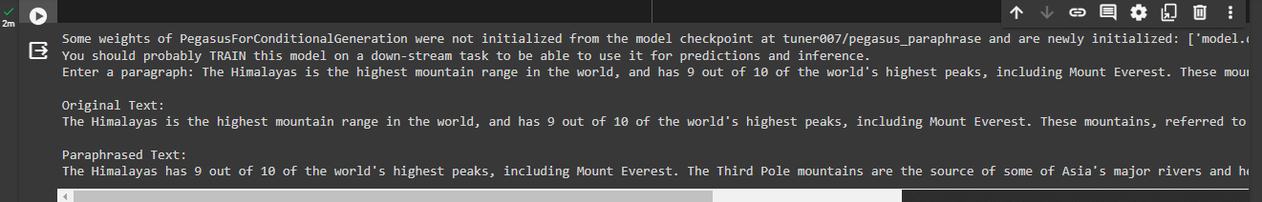
results

Slide 15
Source code @github:
https://github.com/Lakshmiragupathy/Nan-mudhalvan--TNSDC.git
THANK YOU

